Slide 1
Green School Awards Program
Application Process for PPPCS

Slide 2
Maryland Association for Environmental and Outdoor Educators
Mission is to encourage, train & support Maryland educators to build a citizenry that understands and is responsibly engaged in promoting sustainability, addressing human needs, and conserving Earth’s natural resources.
1997- Green School Awards Program announced.

Slide 3
What does it mean to be “green”?
Schools are recognized for having made a commitment to environmental education
authentic learning
local environment issue investigation
professional development with EE best practices
community stewardship
Review process: non-competitive
Schools must re-apply every 3 years
24 Baltimore City Schools recognized as of May 2012
Notes:
integrated approach to authentic learning that incorporates local environmental issue investigation and professional development with environmental best management practices and community stewardship.

Slide 4
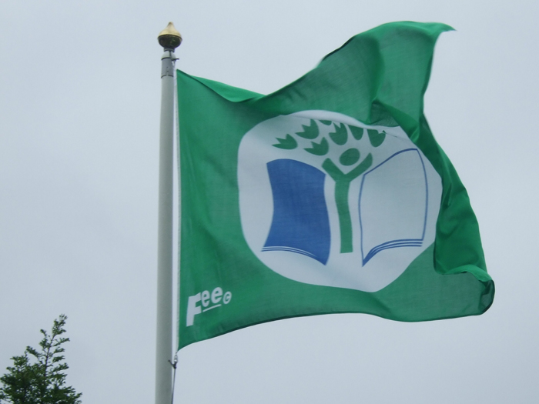
PLUS….
The bonus of this
flag at 27 N. Lakewood Ave!

Slide 5
What does a Green School look like?
Students have opportunities at all grade levels and across disciplines to learn about and address environmental issues
In the classroom
On the school site
Within the local and regional community

Slide 6
Past Green School Achievements
Implementation of school-wide recycling program
Trashless Tuesdays or Waste-free Wednesdays
Built a native plant garden with raised beds
Schoolwide fundraiser benefitting “Pennies for the Planet”
Storm drain stenciling
Shad raise and release program
Rain garden
Environmental/outdoor field trips

Slide 7
Being Green Helps our Students
Develop a “Sense of Place”
Exposing them to the interconnectedness of life
What is my role in the community and the environment?
Develop Place Attachment
Builds an emotional bond to a place
Authentic EE activities allow students to examine their role in the community and the environment.
Notes:
-Meanings of the place as well as their attachments for that place
-Through engaging students in place-making activities we can nurture our students’ emotional attachments to features of their local natural community. Whether in vacant lots, local parks, or in forests, we can afford children opportunities to develop emotional bonds with the natural world and to explore and to create special places as they situate themselves in the world. By doing so, we may nurture students’ attachment to place.

Slide 8
Evidence for Achievement Effects
Research on effective schools shows that students’ sense of connectedness to school and community is an important element of achievement.
significantly enhanced student performance on standardized multi-disciplinary achievement tests
significantly improved student achievement motivation and critical-thinking skills
more collaborative and interdisciplinary practice, and more frequent use of service learning projects, by teachers

Slide 9
Resources for Teachers
Project Wet, Wild, and Learning Tree (sharepoint)
Maryland Department of Natural Resources
http://www.dnr.state.md.us/education/classroom.asp
Chesapeake Bay Foundation
http://www.cbf.org/about-cbf/our-mission/educate

