Slide 1
Today, SWBAT
Explore patterns of waste disposal and recycling in the United States
TOMORROW - Identify number patterns & construct expressions containing variables that represent real-world patterns
Use tables and graphs to organize data

Slide 2
Explore patterns of waste disposal and recycling in the United States
Where does it go after it is used?
Can it be reused? If so, in what way?

Slide 3
Glass bottle – can be used over
and over, and can be recycled into
other glass materials
Plastic (bags) can be recycled to
make carpets, fleece clothing, and many other items
Newspapers can be recycled to paper, tissues and new newspapers
Coffee grounds can be used to fertilize plants
Cardboard boxes can be reused or recycled into a new cardboard box
Aluminum cans can be reused over and over to create new cans
Rechargeable batteries can be used in multiple products

Slide 4
Recycle vs. throwing it in the trash
Where do you think all of these things would go if you threw all of these products in a garbage can?

Slide 5
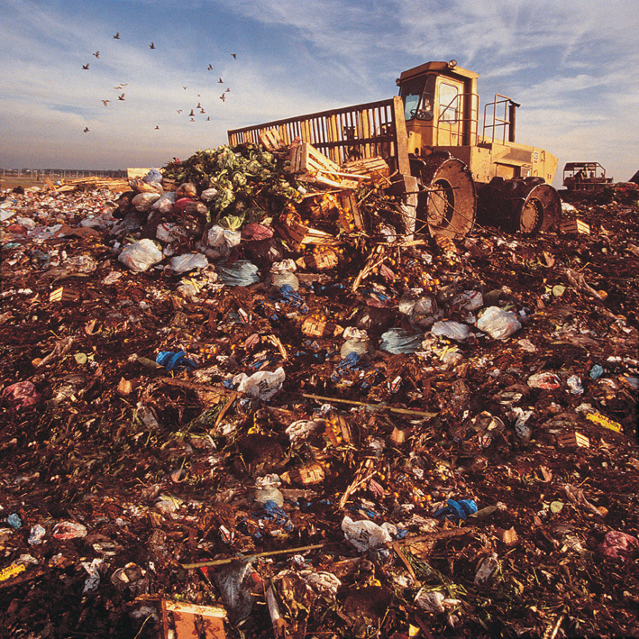
Landfills

Slide 6
6100 Quarantine Rd Baltimore, MD 21264

Slide 8
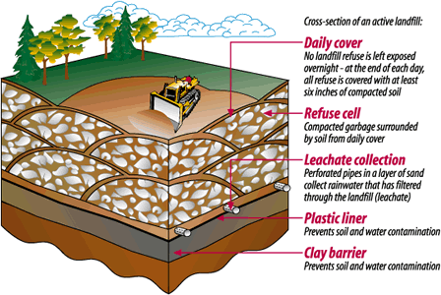
Modern landfills

Slide 9
Landfill concerns
Garbage disposal is no simple matter.
Remember, the threat of contaminating our water and air doesn't just go away when the landfill reaches its capacity.
The garbage continues to decompose, and must be monitored long after the landfill reaches maximum capacity.
(Federal, state and local regulations require a 30 year post-closure monitoring period upon landfill closure.)

Slide 10
Landfill concerns
In the meantime, in another location, the process begins again, as new land must be made available to take in our garbage.
Landfills do not go away, but remain a permanent fixture of our landscape.

Slide 11
You can help!
YOU CAN HELP! Through small changes in your behavior, you can greatly reduce the amount of garbage that you generate.

Slide 12
Plastic bottles
How many soda and water bottles do you use each day?
Guess how many bottles are used in the United States every 5 minutes?
2 million

Slide 13
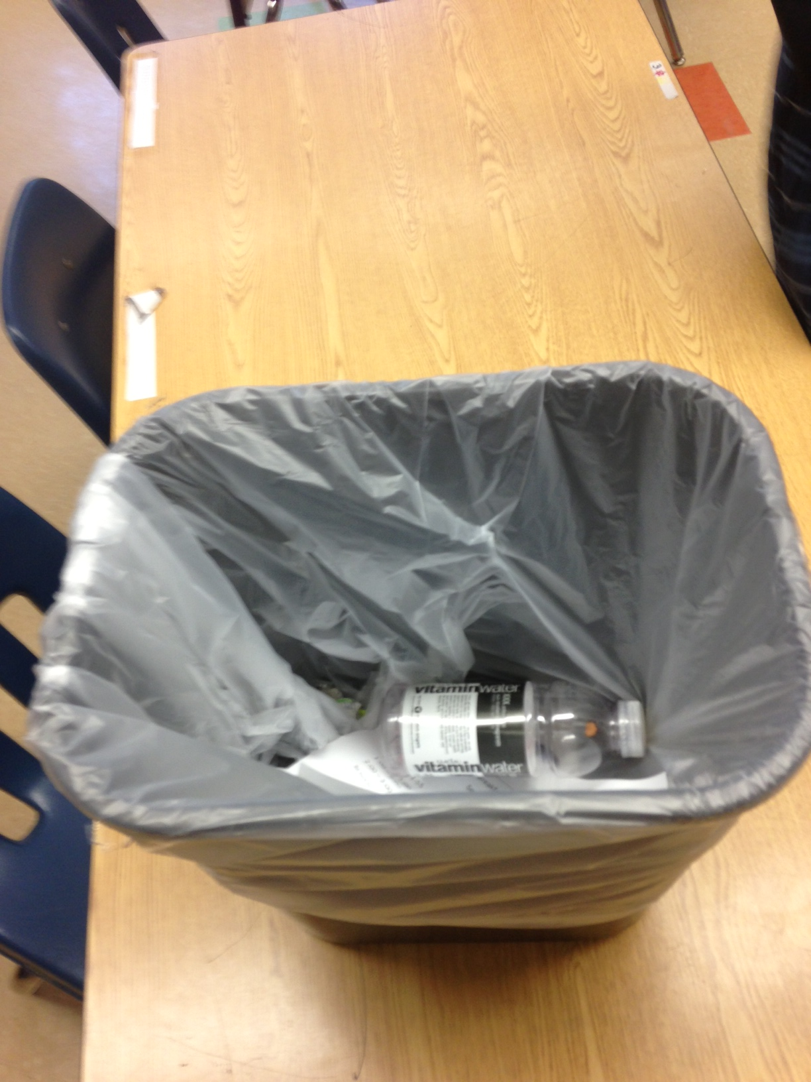
Recycle vs. throwing it in the trash

Slide 14
